Slide 1

A Minor Project Presentation On: Data Integrity Audit Scheme Based on Merkle Tree and Blockchain
Group No. - 7
Rajdeep Nagar 2006117
Kartik Sharma 2006111
Shivam Raj 2006112
Under the Supervision of:
Dr. Kakali Chatterjee
Assistant Professor
Subject Code: CS6490
Date: 04-05-2023

Slide 2
Table of Content
Introduction
Motivation
Objective
Related Work
Proposed Work
Research Gap
Implementation
Insertion and Verification in Sparse Merkle Tree
Insertion and verification in Quad Merkle Tree
Insertion and Verification in Hybrid Merkle Tree
Result
Conclusion

Slide 3
Introduction
In 2019, Capital One, a major US bank, experienced a data breach where the personal information of over 100 million customers was compromised due to a vulnerability in the bank's cloud infrastructure.
Data integrity audit schemes have become an essential component of information security
Merkle tree and blockchain technology have emerged as potential solutions for maintaining data integrity
The combination of Merkle trees and blockchain can provide a powerful solution for data integrity audit schemes
In this paper, we propose a data integrity audit scheme based on Merkle trees and blockchain technology

Slide 4
Motivation
Preventing Data Tampering: With the increasing reliance on digital data storage ensuring the integrity and authenticity of data. The Merkle tree and blockchain-based scheme provides a robust solution to address this issue.
Trust in Data: The scheme ensures that the data has not been tampered with and provides an immutable record of its integrity and authenticity, which enhances trust in the data.
Improved Security: Traditional auditing methods often rely on centralized systems, which can be vulnerable to attacks. In contrast, the Merkle tree and blockchain-based scheme provides a decentralized approach, making it more secure against attacks.

Slide 5
Objective
To observe the Time Complexity of Insertion and verification of transactions in Sparse Merkle Tree, Quad Merkle Tree and Hybrid Merkle Tree.
Based on the analysis, selecting the best tree and use that in data integrity audit scheme based on a Merkle tree and blockchain to provides a secure and reliable method for verifying the integrity and authenticity of data stored on a blockchain.
It can be used in a variety of applications, such as financial transactions, medical records, and supply chain management.

Slide 6
Related Work
Reference # | Proposed | Findings | Limitations
[1] Jianbing Ni | Identity-Based Provable Data Possession From RSA Assumption for Secure Cloud Storage | IB-PDP from RSA assumption provides enhanced security for cloud storage by ensuring that the data stored on the cloud server has not been tampered with. This is achieved by verifying the integrity of the data without revealing the content of the data. | The IB-PDP from RSA assumption protocol is based on the RSA assumption, which assumes that the RSA problem is hard. If the RSA problem is ever found to be solvable in polynomial time, the protocol's security would be compromised.
[2] Yang Yang | An Efficient Identity-Based Provable Data Possession Protocol With Compressed Cloud Storage | The EIB-PDP protocol uses a compressed cloud storage approach to reduce the storage and communication overhead. This approach reduces the amount of data that needs to be stored on the cloud server and transmitted over the network, resulting in a more efficient protocol. | The protocol is relatively complex, and it may require significant resources to implement and maintain.
[3] Genqing Bian | Certificateless Provable Data Possession Protocol for the Multiple Copies and Clouds Case | The CL-MC2-PDP protocol supports data redundancy across multiple cloud servers, making it suitable for cloud storage systems that use multiple cloud servers to store user data. | The protocol requires the management of public and private keys for each user and cloud server. This could be a challenge for cloud storage providers with a large number of users and multiple cloud servers.

Slide 7
[4] Françoise Levy-dit-Vehel | A Framework for the Design of Secure and Efficient Proofs of Retrievability | The POR protocol should provide strong security guarantees, ensuring that the data stored on the cloud server has not been tampered with or deleted. | The framework is relatively complex, and it may require significant resources to implement and maintain.
[5] Xiao Zhang | Proofs of retrievability from linearly homomorphic structure-preserving Tag natures | The homomorphic structure of the LH-SP tags enables efficient verification of multiple tags at once, reducing the overhead of verifying the integrity of multiple files. | The LH-SP Tag-based PoR protocol may not be applicable to all cloud storage systems, as it requires the use of LH-SP tags and bilinear pairings.
[6] Binanda Sengupta | Efficient Proofs of Retrievability with Public Verifiability for Dynamic Cloud Storage | The protocol provides public verifiability, which allows anyone to verify the integrity of the data without requiring any secret information. | The protocol does not support efficient verification of dynamic data updates, which could be a limitation for cloud storage systems with frequent updates.
[7] L. Zhu, Y. Wu, K. Gai | Controllable and trustworthy blockchain-based cloud data management | The use of blockchain technology enables decentralized management of data, eliminating the need for a central authority to manage access and modification of data.
[8] L. Min | Integrity verification for multiple data copies in cloud storage based on quad merkle tree. | This provides strong security guarantees, ensuring that the data copies have not been tampered with or deleted. | The method is based on quad merkle, which may require expertise and resources to implement and maintain.

Slide 8
Research Gap
One potential research gap in this area is the exploration of the practical applications of using Merkle trees with the least verification time for data integrity verification.
Minimizing verification time can enhance the efficiency and scalability of the data integrity audit scheme, especially in large-scale and complex system.
Aimed to enhance the efficiency and scalability of the data integrity audit scheme by minimizing the verification time while ensuring the security and accuracy of data verification.

Slide 9
Proposed Work
This report proposes a data integrity auditing scheme based on a Merkle hash tree and blockchain, aiming to improve the efficiency and security of data storage.
The scheme uses blockchain instead of a third-party auditor to ensure reliability and prevent data tampering.
We are going to analyze the time complexity and space complexity of different types of Merkle Tree’s.
Among SMT, Quad Merkle tree and Hybrid Merkle tree We are going to choose the efficient one based on time complexity analysis.

Slide 10
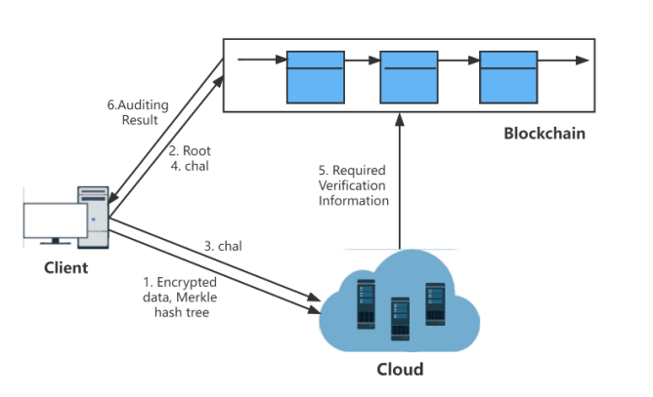
System model of a blockchain based cloud storage auditing scheme
Fig 1: System model

Slide 11
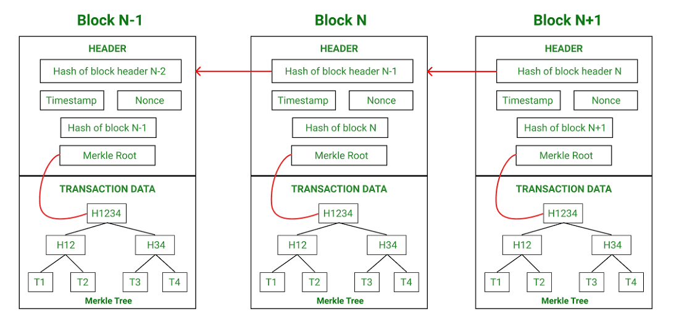
Merkle Tree on a Blockchain
Fig 2: Blockchain and Merkle Tree

Slide 12
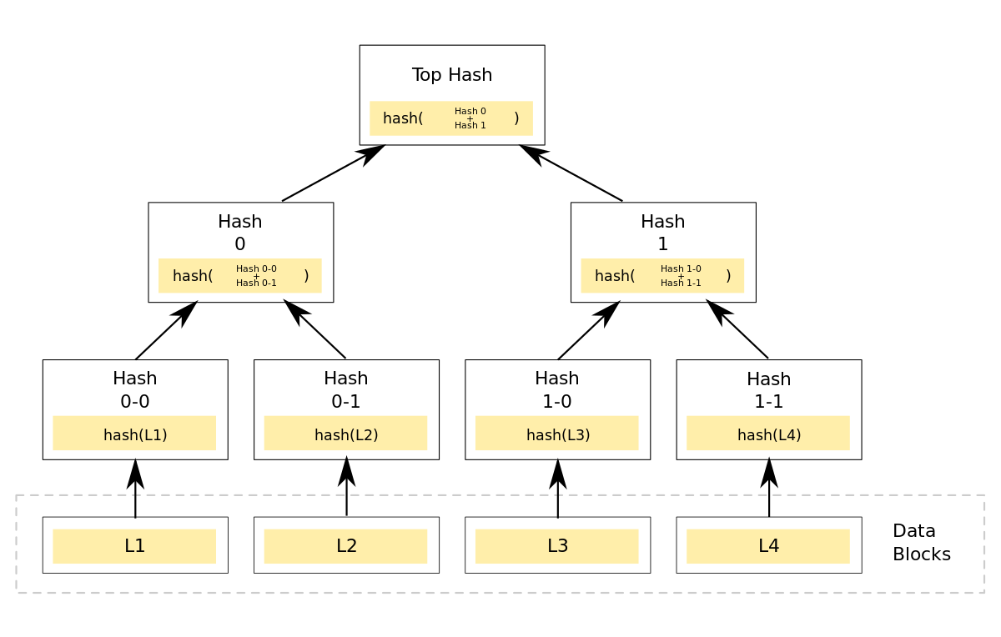
Sparse Merkle Tree
Time Complexity:
Insertion: O(logn)
Verifying: O(mlogmn)
Space Complexity: O(n)
n: Total number of transactions inserted in the tree
m: Number of branches in the tree, m=2 for SMT
Fig 3: Sparse Merkle Tree

Slide 13
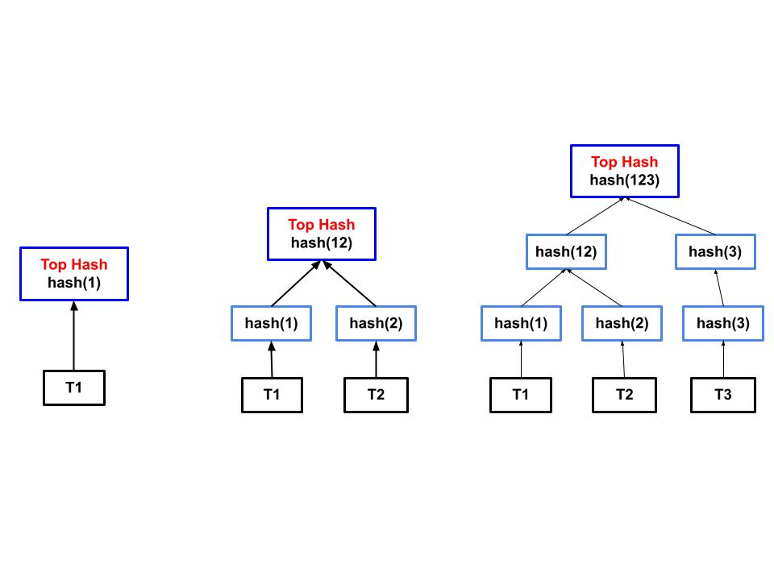
Insertion In Sparse Merkle Tree
Fig 4: Sparse Merkle Tree Insertion

Slide 14
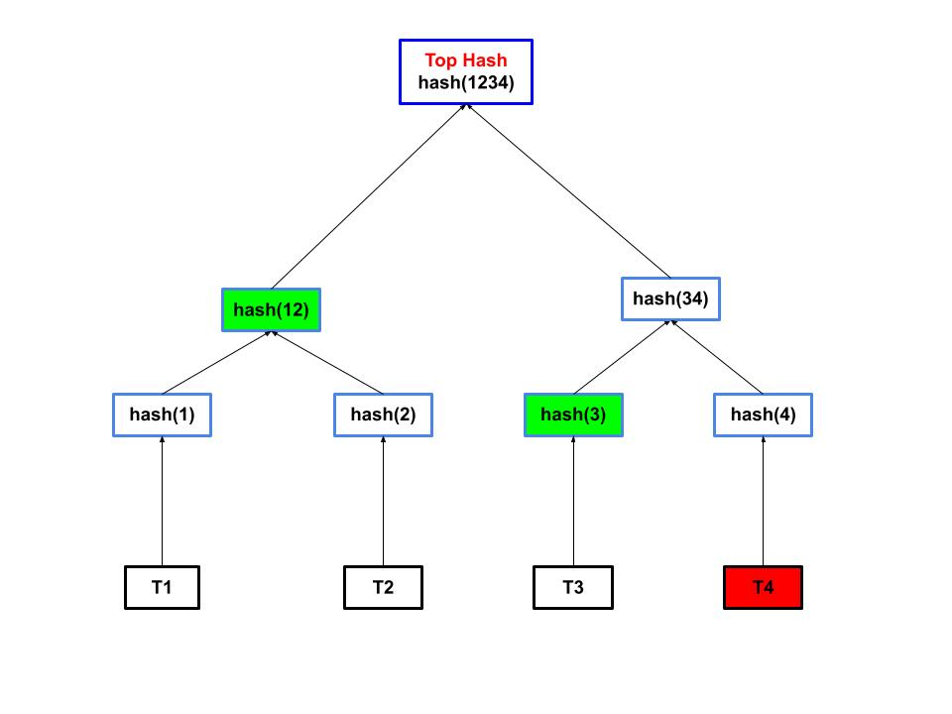
Verification in Sparse Merkle Tree
Fig 5: Sparse Merkle Tree Verification

Slide 15
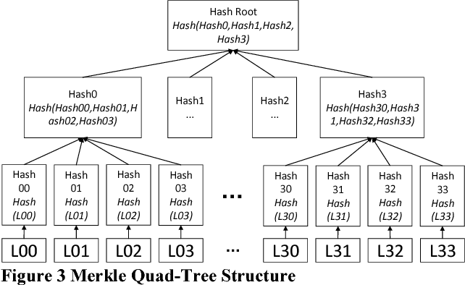
Quad Merkle Tree
Time Complexity:
Insertion: O(log4n)
Verification: O(mlogmn)
Space Complexity: O(n)
n: Total number of transactions inserted in the tree
m: Number of branches in the tree, m=4 for QMT
Fig 6: Quad Merkle Tree

Slide 16
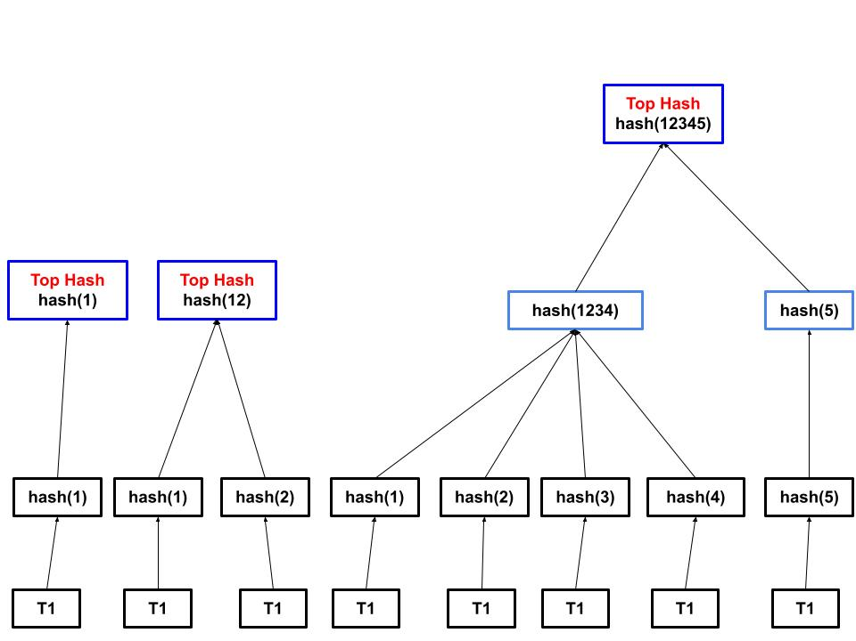
Insertion In Quad Merkle Tree
Fig 7: Quad Merkle Tree Insertion

Slide 17
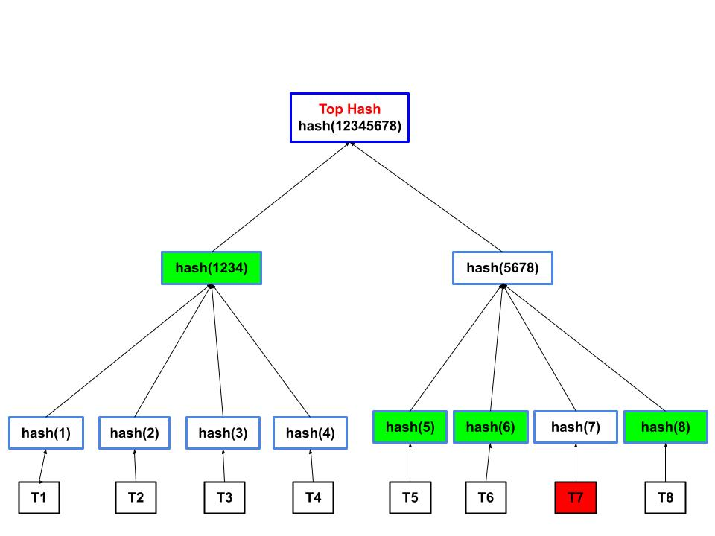
Verification in Quad Merkle Tree
Fig 8: Quad Merkle Tree Verification

Slide 18
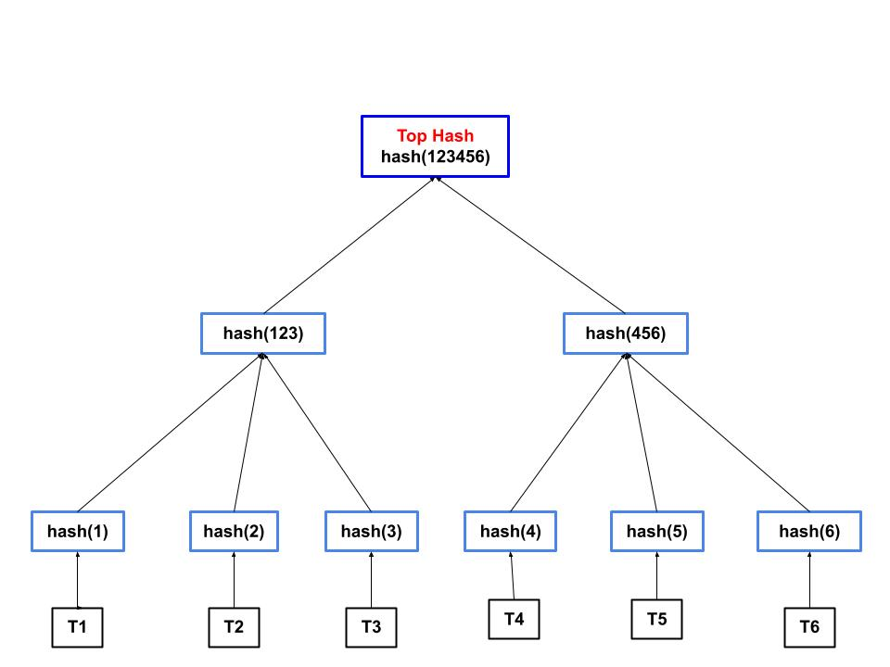
Hybrid Merkle Tree
Time Complexity:
Insertion: O(n)
Verification: O(log3n)
Space Complexity: O(n)
n: Total number of transactions
inserted in the tree
m: Number of branches in
the tree, m=3 for HMT
H 1-0
Fig 9: Hybrid Merkle Tree

Slide 19
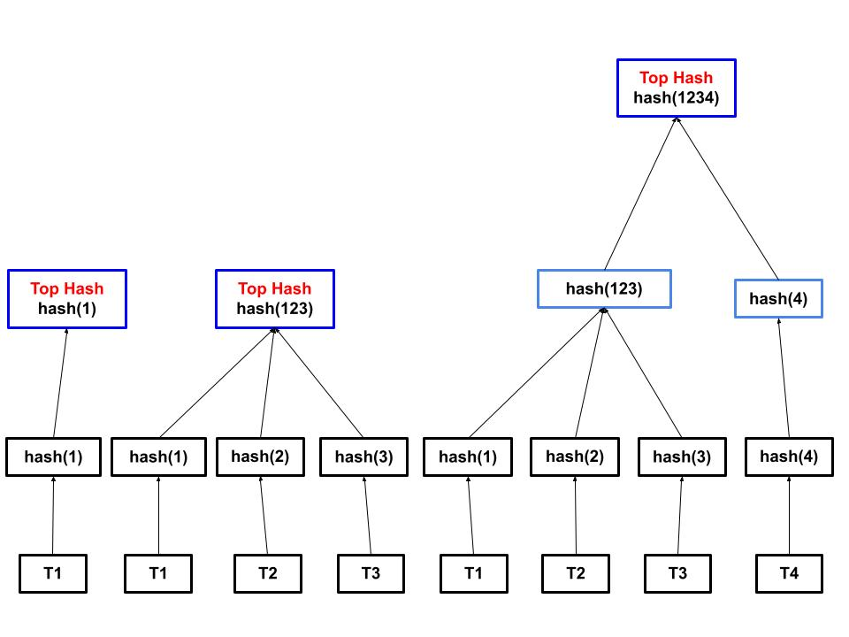
Insertion in Hybrid Merkle Tree
Fig 10: Hybrid Merkle Tree Insertion

Slide 20
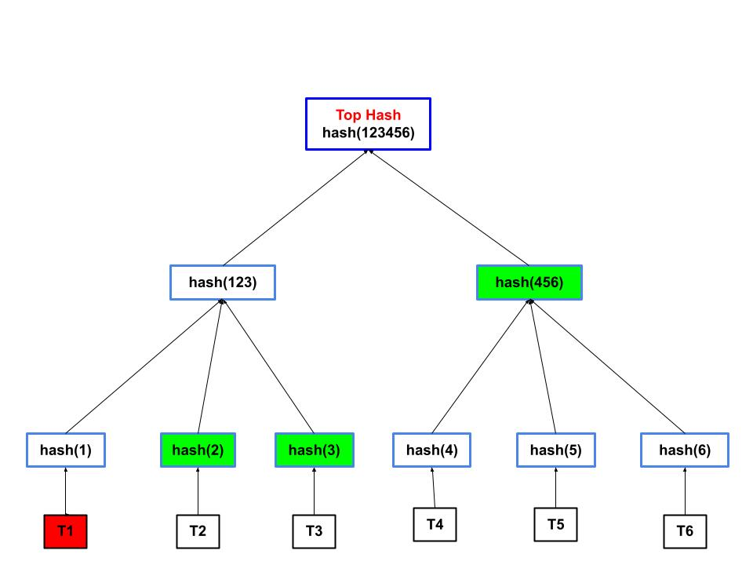
Verification in Hybrid Merkle Tree
Fig 11: Hybrid Merkle Tree Verification

Slide 21
Data Collection:
Insertion timings for the trees:
 | TIME TAKEN BY TREES
NUMBER OF INSERTED TRANSACTIONS | SMT | HYBRID | QUAD
10 | 562 | 556 | 541
30 | 1637 | 1546 | 1495
100 | 4774 | 4707 | 4681
150 | 7977 | 7970 | 7827
200 | 17812 | 16872 | 14786
500 | 27752 | 26982 | 24916
700 | 40025 | 38901 | 38751
1000 | 58235 | 57874 | 55827 |  | TIMINGS ARE IN MICROSECONDS
Fig 12: Insertion Data of trees

Slide 22
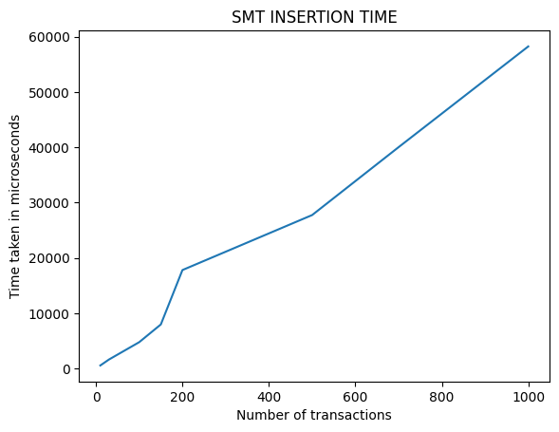
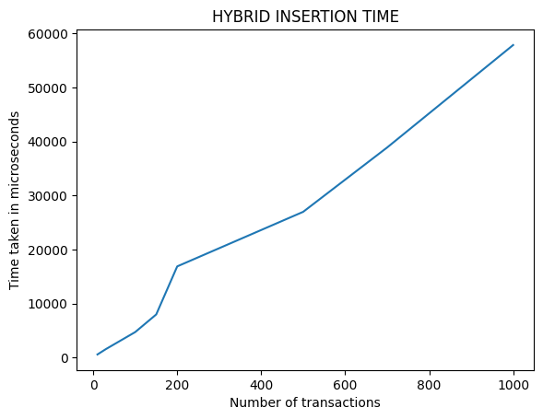
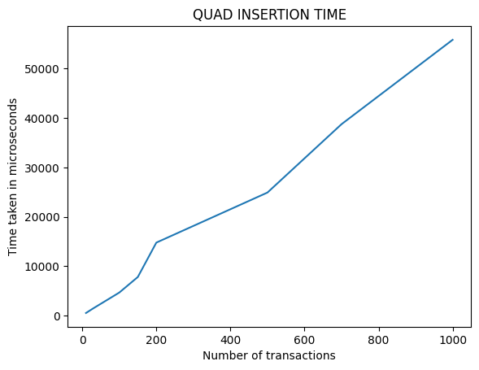
Graphical Representation of above data
Fig 13: Graphs for Insertion

Slide 23
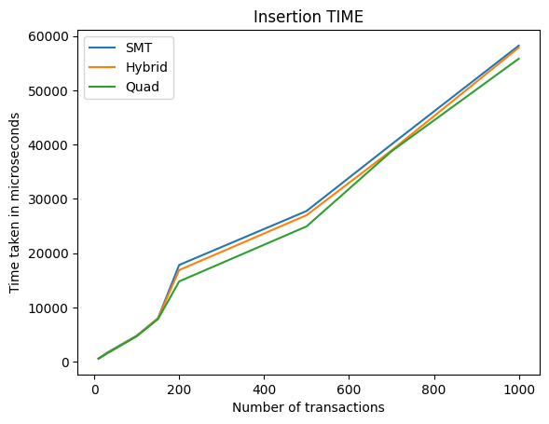
Comparison of Insertion time of trees
Fig 14: Comparison Graph for Insertion

Slide 24
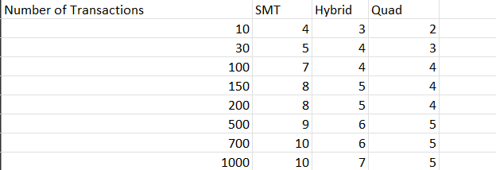
Height of trees for different inputs
Fig 15: Height of trees

Slide 25
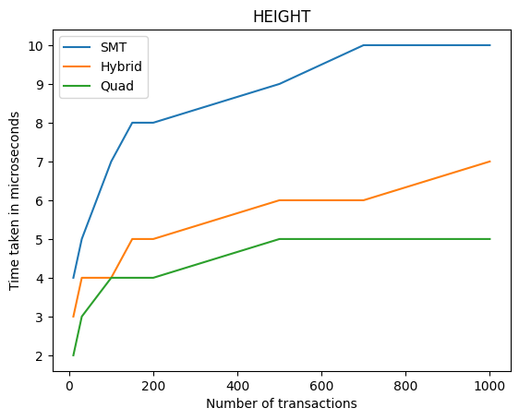
Graphical Representation of Height
Fig 15: Graphs for Heights

Slide 26
Verification timings for the trees:
NUMBER OF TRANSACTIONS TO VERIFY | SMT | HYBRID | QUAD
10 | 6685 | 9171 | 20675
30 | 12159 | 23089 | 64329
100 | 27806 | 79688 | 193064
150 | 32426 | 104021 | 302984
200 | 43286 | 134007 | 370781
500 | 115215 | 300680 | 854827
700 | 142105 | 445188 | 1317996 |  | TIMINGS ARE IN MICROSECONDS
1000 | 200918 | 602729 | 1934006
Fig 17: Verification Data of trees

Slide 27
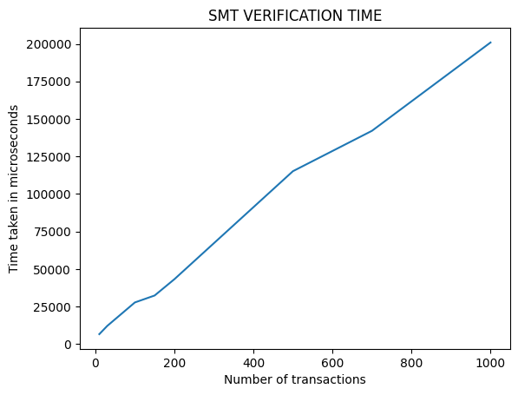
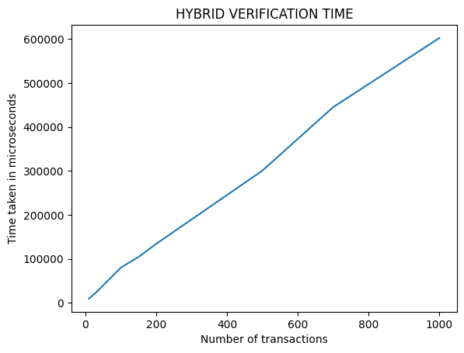
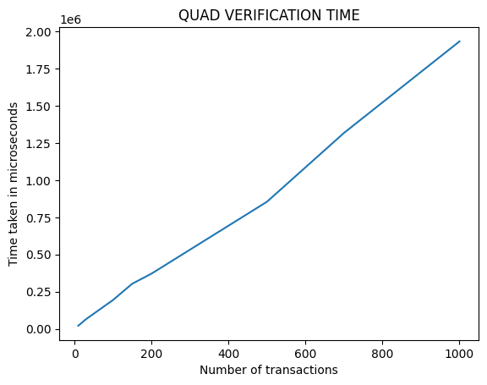
Graphical Representation of above data
Fig 18: Graphs for Verification

Slide 28
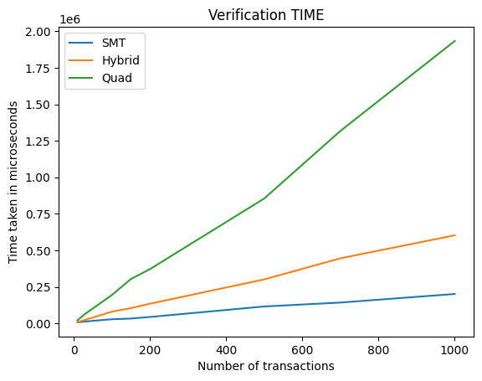
Comparison of Verification time of trees
Fig 19: Comparison Graph for Verification

Slide 29
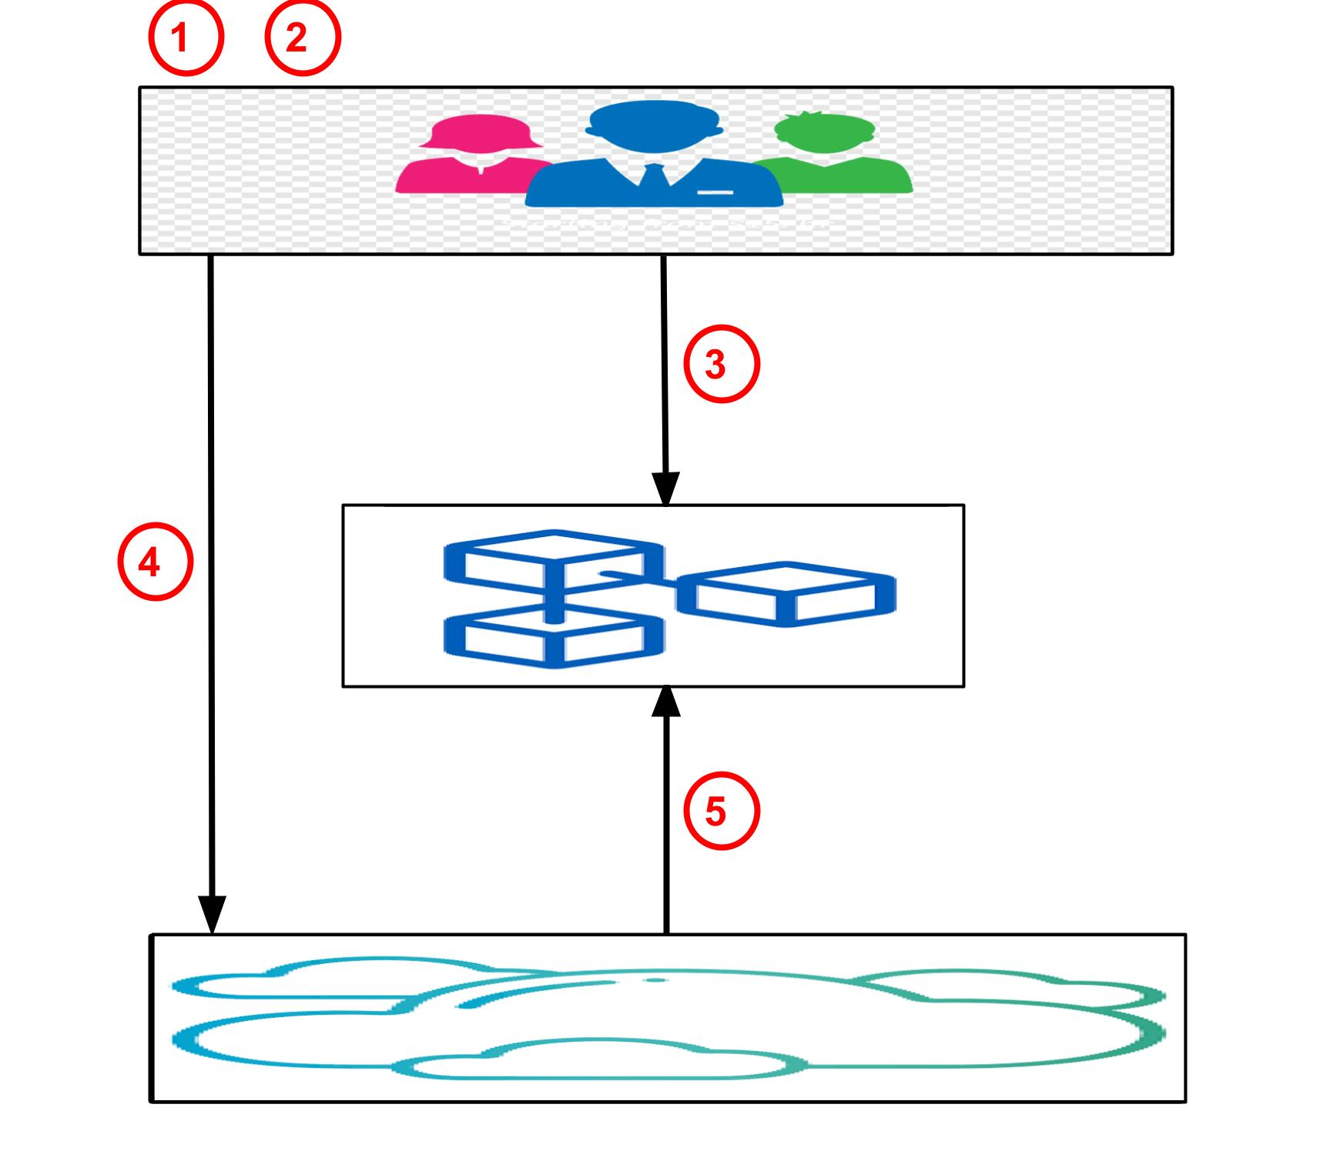
Initialization Phase
Slice the data file
Calculate the data hash and generate the Merkle hash tree.
Send Merkle hash tree root .
Encrypted data files and Merkle hash trees.
Verify data file integrity
Fig 20: The process of initialization phase

Slide 30
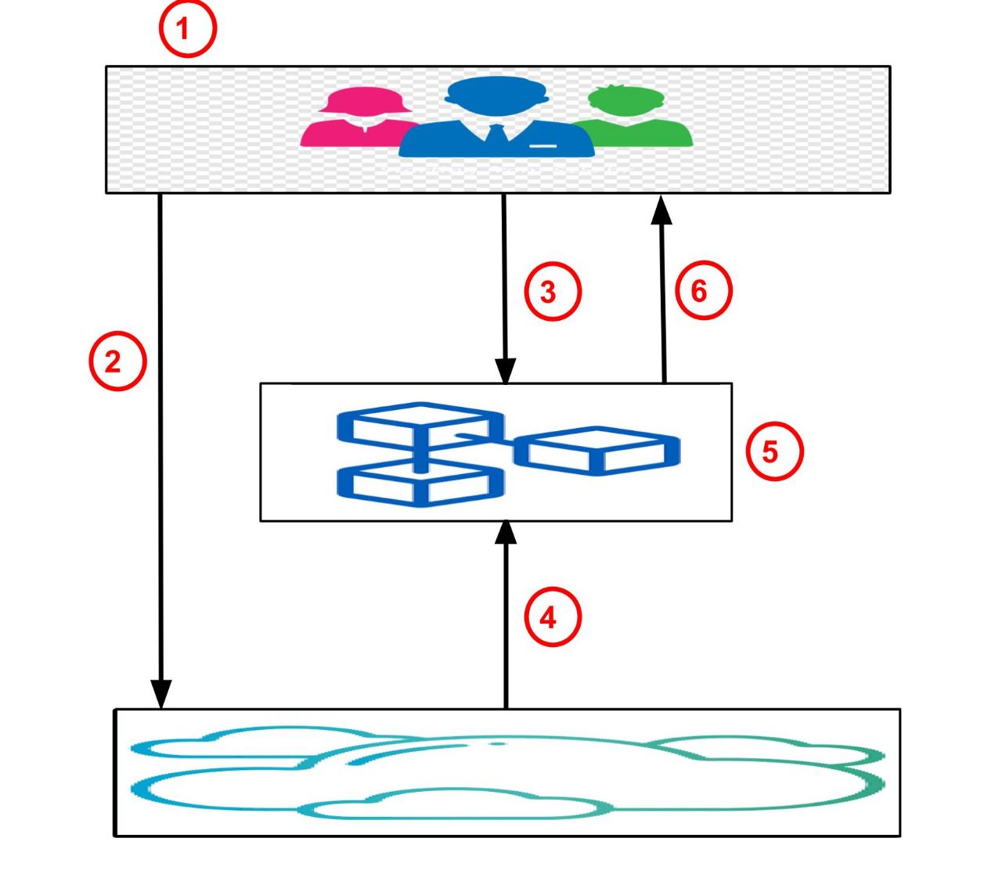
Verification Phase
Generate audit query chal.
Send chal.
Send chal.
Send the relevant hashes, signatures, random queries and auxiliary information.
Calculate Root’ and compare whether Root’ and Root are equal. .
Verify the result.
Fig 21: The process of verification phase

Slide 31
Security Analysis
AUDIT REASONABLENESS
Anti-forgery attack
Cloud forges data information with the intention of deceiving the blockchain and the client to pass verification.
It causes a change in the root of the Merkle tree generated by its signatures.
Original hash tree root value Root stored on the blockchain will not change.
Then it will be impossible to pass the verification.
Anti-fraud attack
The client uploads corrupt data blocks and then claims that the data is intact to trick the cloud into getting compensation.
To avoid this, the cloud performs a verification before storing the client's data.
Cloud verifies the integrity of the data to the blockchan.

Slide 32
Security Analysis…
DATA PRIVACY
The specific information in the data file is not visible to the cloud.
what the cloud has is the encrypted data file and its signature.
The signature set hides the data information well using hash functions, system parameters, client public keys, etc.
DETECTABILITY
Data stored in the cloud, if corrupted, can be detected with a probability of no less than 1 −((𝑛−𝑥)/n)m.
This probability is equivalent to that in 1,000,000 data blocks, if 1% of the data blocks are damaged, the verifier only selects 300 data blocks, and the detection rate reaches 95%.
In one challenge, the confidence level CL = P >= 1 −((𝑛−𝑥)/n)m.

Slide 33
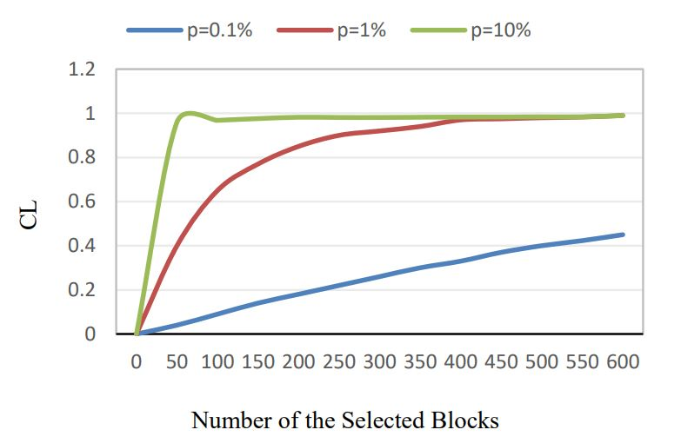
Confidence level
P=x/n
Fig 23: Confidence level for different probabilities that TPA can detect the corrupted data

Slide 34
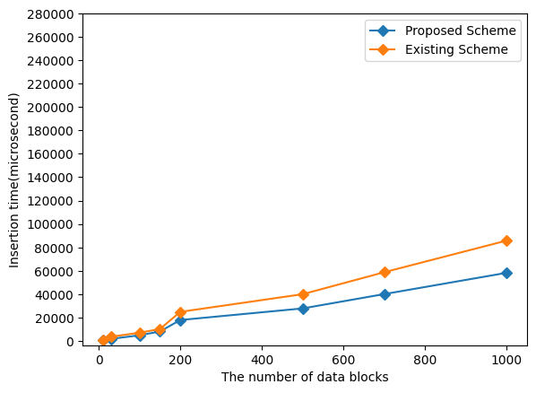
Relationship between insertion time and the number of data blocks
Fig 25: . Relationship between insertion time and the number of data blocks

Slide 35
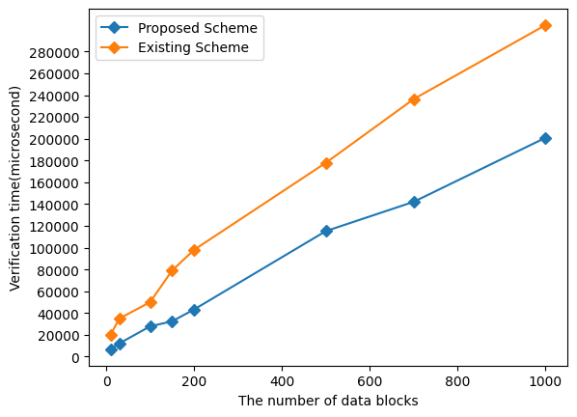
Relationship between audit verification phase time and number of data blocks
Fig 26: Relationship between audit verification time and number of data blocks

Slide 36
Conclusion
Using blockchain instead of a third-party auditor ensures the reliability of data auditing.
The audit based on the Sparse Merkle hash tree improves the efficiency of computing and storage.
The feasibility of our scheme is proved, and the comparative experiments with other schemes confirm that the scheme outperforms other schemes in terms of blockchain computational overhead.
The experimental analysis shows that our scheme achieves the expected security and efficiency goals.

Slide 37
References
[1] Jianbing Ni, Kuan Zhang, Yong Yu, Tingting Yang: Identity-Based Provable Data Possession From RSA Assumption for Secure Cloud Storage. IEEE Trans. Dependable Secur. Comput. 19(3): 1753-1769 (2022)
[2] Yang Yang, Yanjiao Chen, Fei Chen, Jing Chen: An Efficient Identity-Based Provable Data Possession Protocol With Compressed Cloud Storage. IEEE Trans. Inf. Forensics Secur. 17: 1359-1371 (2022)
[3] Genqing Bian, Jinyong Chang, “Certificateless Provable Data Possession Protocol for the Multiple Copies and Clouds Case,” IEEE Access 8: 102958-102970 (2020).
[4] Françoise Levy-dit-Vehel, Maxime Roméas:A Framework for the Design of Secure and Efficient Proofs of Retrievability. IACR Cryptol. ePrint Arch. 2022: 64 (2022)
[5] Xiao Zhang, Shengli Liu, Shuai Han,“Proofs of retrievability from linearly homomorphic structure-preserving Tag natures,” Int. J. Inf. Comput. Secur. 11(2): 178-202 (2019).
[6] Binanda Sengupta, Sushmita Ruj,“Efficient Proofs of Retrievability with Public Verifiability for Dynamic Cloud Storage,”IEEE Trans. Cloud Comput. 8(1): 138-151 (2020).

Slide 38
References …
[7] L. Zhu, Y. Wu, K. Gai, and K.-K. R. Choo, “Controllable and trustworthy blockchain-based cloud data management,” Future Generation Computer Systems, vol. 91, pp. 527–535, 2019.
[8] L. Min, L. You and P. Fei, “Integrity verification for multiple data copies in cloud storage based on quad merkle tree” IEEE International journal of bifurcation and Chaos, vol 27, no 4, 2017

Slide 39
THANK YOU !

